Slide 1

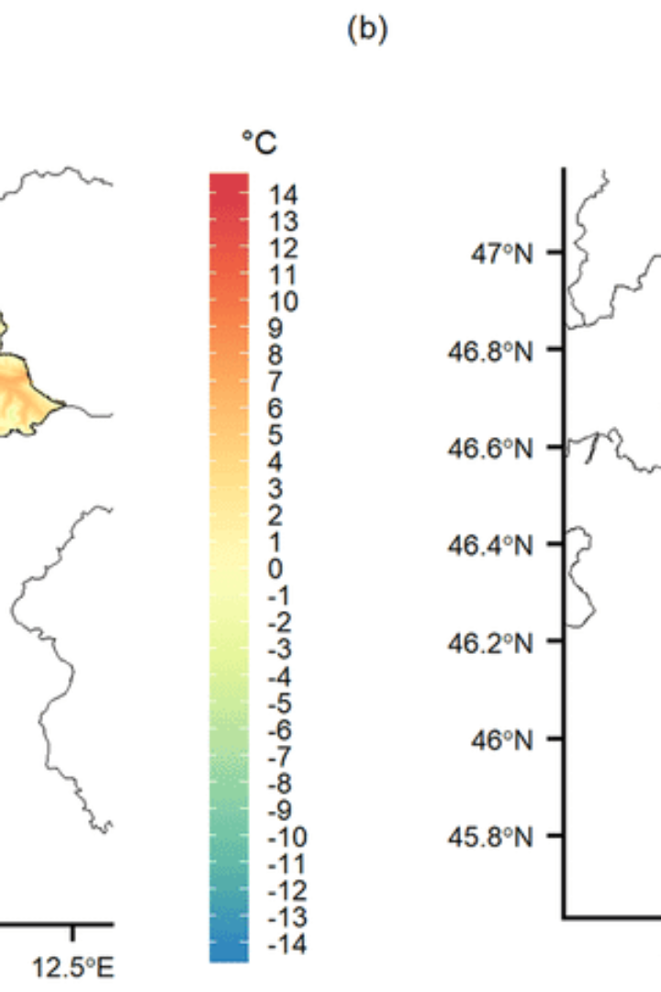

Weather Data Analysis Report
This report presents a detailed analysis of a comprehensive weather dataset covering temperature, precipitation, and wind speed across different states in the United States. The analysis aims to uncover patterns, correlations, and insights applicable to travel planning, agricultural decision-making, and understanding climate trends.
by BENJAMIN ODAME

Slide 2

Objectives
Comprehend temperature and precipitation trends
Identify geographical variations in climate
Detect extreme weather events and variability
Evaluate states for travel suitability based on monthly weather conditions

Slide 3
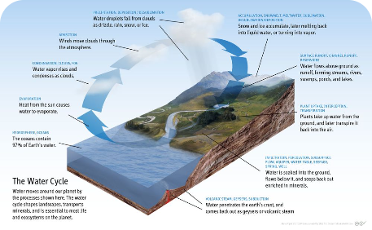
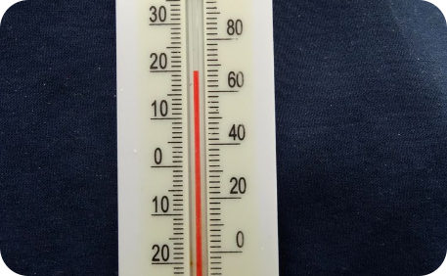
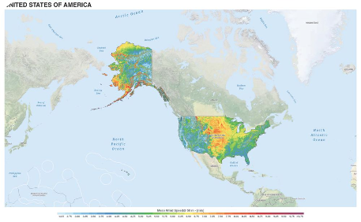
Dataset Overview
Precipitation
Temperature
Wind Speed
Measure of the amount of rainfall, a crucial parameter for various applications like agriculture and travel planning.
Includes average, maximum, and minimum temperatures, providing vital information for understanding seasonal weather patterns.
Details about wind direction and speed, vital for applications such as climate trend analysis and wind energy projects.

Slide 4
Dataset Overview
Date.Full: The date of observation.
Data.Temperature.Avg Temp: Average temperature recorded.
Date.Month: Month of observation.
Data.Temperature.Max Temp: Maximum temperature recorded.
Date.Year: Year of observation.
Station.City: City where the observation was made.
Data.Temperature.Min Temp: Minimum temperature recorded.
Station.State: State where the observation was made.
Data.Precipitation: Precipitation amount.
Data.Wind.Speed: Wind speed.

Slide 5

Seasonal Weather Patterns
1
Winter
Average Temperature 37.33°F, Average Precipitation 0.54 inches
2
Spring
Average Temperature 55.08°F, Average Precipitation 0.58 inches
3
Summer
Average Temperature 73.80°F, Average Precipitation 0.70 inches
4
Fall
Average Temperature 59.59°F, Average Precipitation 0.50 inches

Slide 6
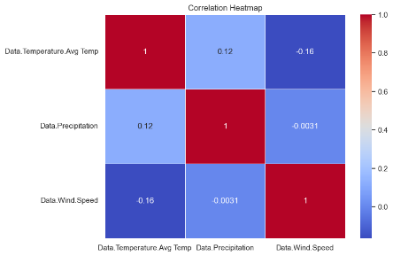
Correlation Analysis
Positive Correlation
A weak positive correlation between temperature and precipitation, indicating potential relationships between these variables.
Negative Correlation
No Significant Correlation
A weak negative correlation between temperature and wind speed, highlighting the impact of wind on temperature conditions.
Lack of significant correlation between precipitation and wind speed, suggesting independent nature of these variables.

Slide 7
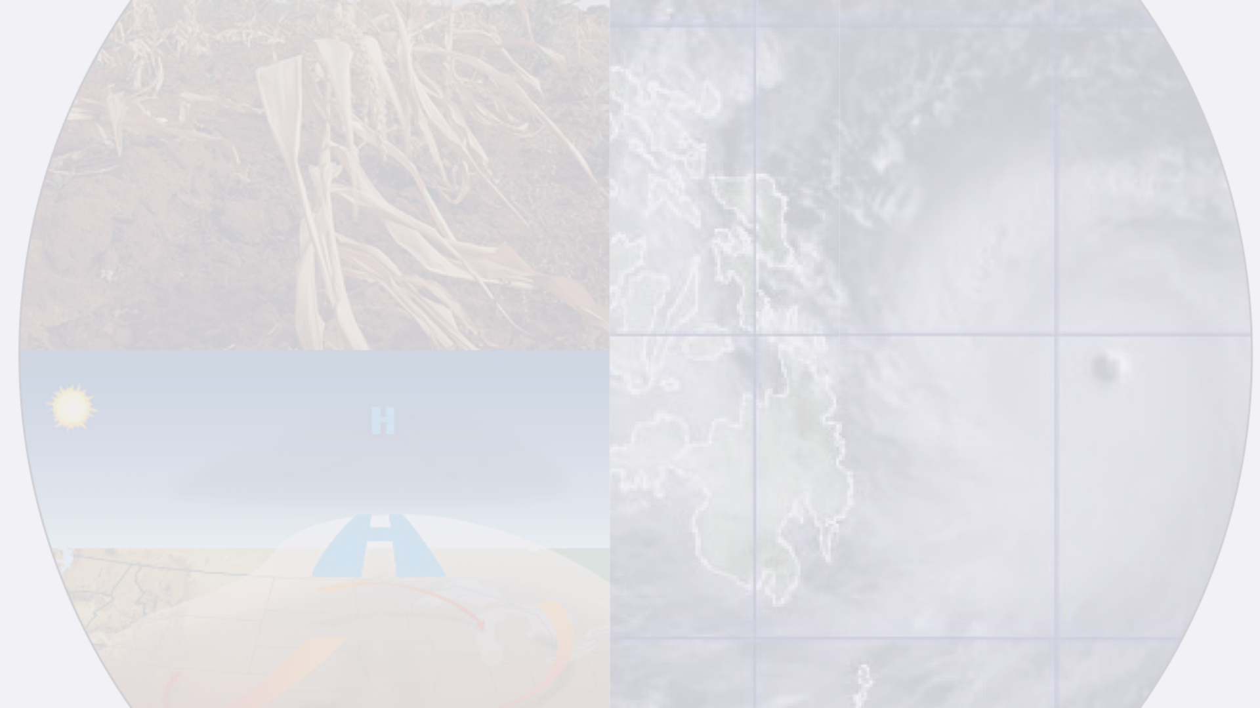
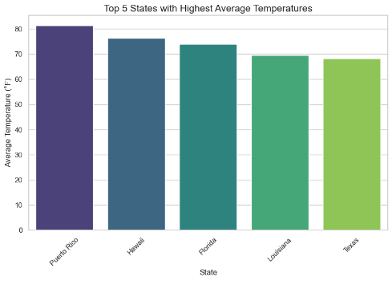
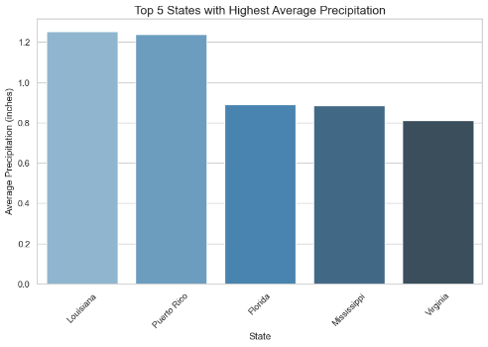
Analysis of Extreme Weather Events
Extreme Temperature and Precipitation
Identification of extreme temperature and precipitation events, with emphasis on states such as Texas, Arizona, Puerto Rico, Alaska, and Louisiana.

Slide 8
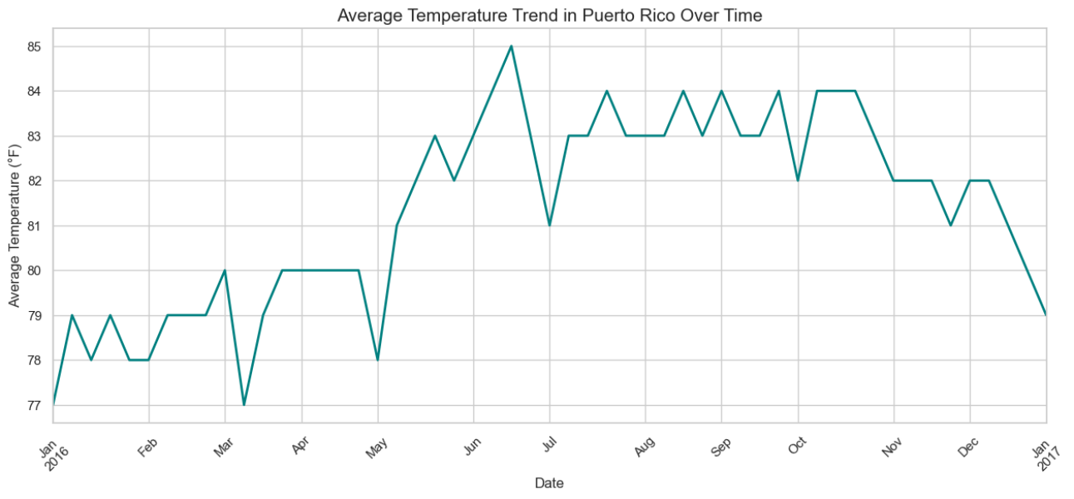
Temperature Trends in Puerto Rico
Insightful Analysis
Detailed analytical review of temperature trends in Puerto Rico, depicting fluctuations and patterns over time.

Slide 9


State Visit Recommendations
Monthly Recommendations
Guiding suggestions for states to visit based on comfortable temperatures (60°F to 80°F), providing a guide for potential travel planning.
January: Hawaii, Puerto Rico, Florida February: Hawaii, Florida, Puerto Rico March: Florida, Hawaii, Louisiana April: Florida, Louisiana, Texas May: Mississippi, South Carolina, Texas June: Colorado, Pennsylvania, Wisconsin July: Maine, North Dakota, Wyoming August: Oregon, Maine, Colorado September: Ohio, Rhode Island, Connecticut October: Mississippi, Alabama, Georgia November: Florida, Louisiana, Texas December: Florida, Hawaii

Slide 10
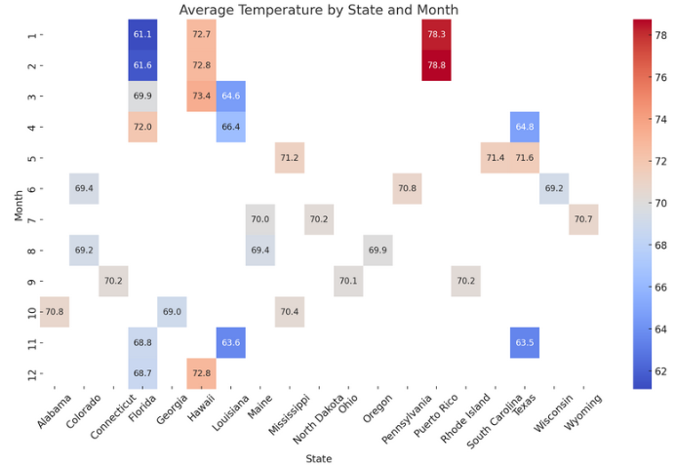
States Trips Advisor Based on Temperature
January: Hawaii, Puerto Rico, Florida February: Hawaii, Florida, Puerto Rico March: Florida, Hawaii, Louisiana April: Florida, Louisiana, Texas May: Mississippi, South Carolina, Texas June: Colorado, Pennsylvania, Wisconsin July: Maine, North Dakota, Wyoming August: Oregon, Maine, Colorado September: Ohio, Rhode Island, Connecticut October: Mississippi, Alabama, Georgia November: Florida, Louisiana, Texas December: Florida, Hawaii
Months names have been represented by the numbers on the y-axis

Slide 11
Conclusions
The analysis of the weather dataset reveals significant insights into seasonal patterns, temperature and precipitation extremes, and general weather trends across the United States.
These findings are valuable for understanding regional climatic conditions, planning travel or events based on favorable weather, and potentially guiding agricultural practices. The dataset also shows potential for further studies, including long-term climate change indicators and predictive weather modeling.

Slide 12
Additional Observations
Long-term Trends
Regional Comparisons
Predictive Analyses
The weather data offers opportunities for deeper analyses such as long-term trends that could indicate climate change impacts.
Regional comparisons can be made to understand the climatic differences across various parts of the United States.
The data can be used to model future weather conditions, aiding in predictive analyses for various sectors.

